Slide 1
Cyberinfrastructure for Thermochemical Computation
Christopher Paolini
Computational Science Research Center and
Department of Mechanical Engineering
San Diego State University

Slide 2
Acknowledgement
NSF Office of CyberInfrastructure CI-TEAM Grant #0753283
Subrata Bhattacharjee, Professor of Mechanical Engineering at San Diego State University
Kris Stewart, Professor of Computer Science at San Diego State University
Mary Thomas, Doctoral Student in Computational Science at San Diego State University

Slide 3
Discussion Topics
Mathematical overview of chemical equilibrium computation for thermal-fluid applications
Cyberinfrastructure for acquisition and dissemination of thermochemical data
Cyberinfrastructure for equilibrium computation
Example CI applications: bomb calorimetry and combustion RIAs
Closing remarks
Current publications resulting from this research

Slide 4
Modeling Chemical Equilibrium:
Minimization of the Gibbs Function
Notes:
4

Slide 5
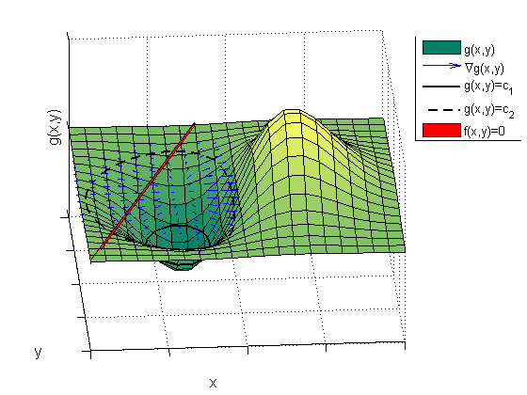
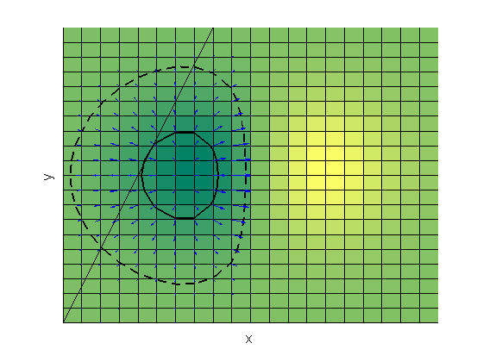
Constrained Optimization using the Method of Lagrange Multipliers
Notes:
5

Slide 6
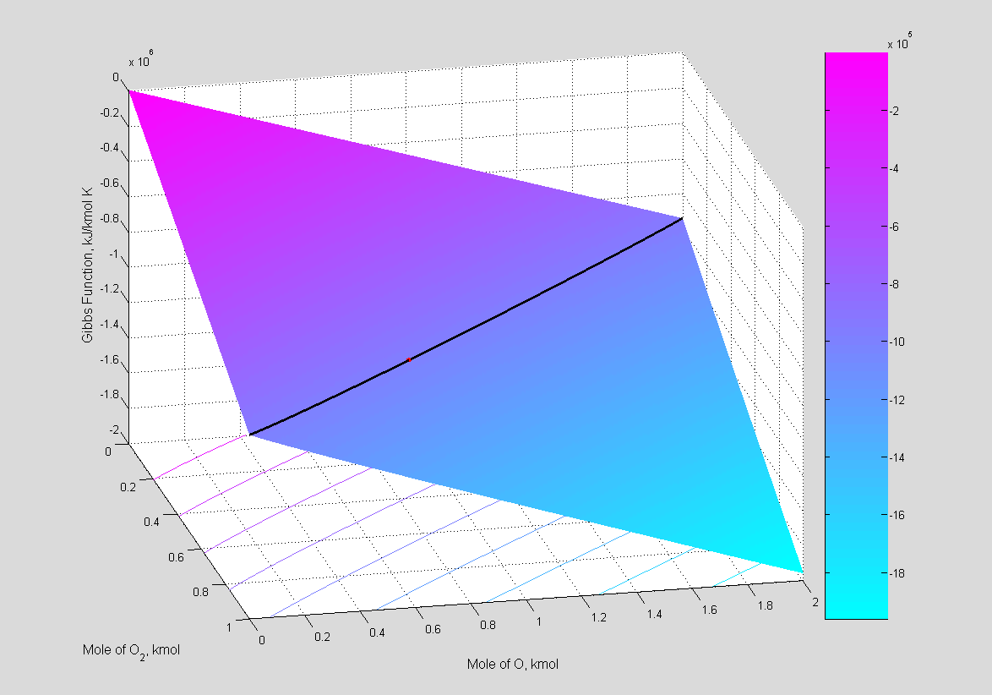
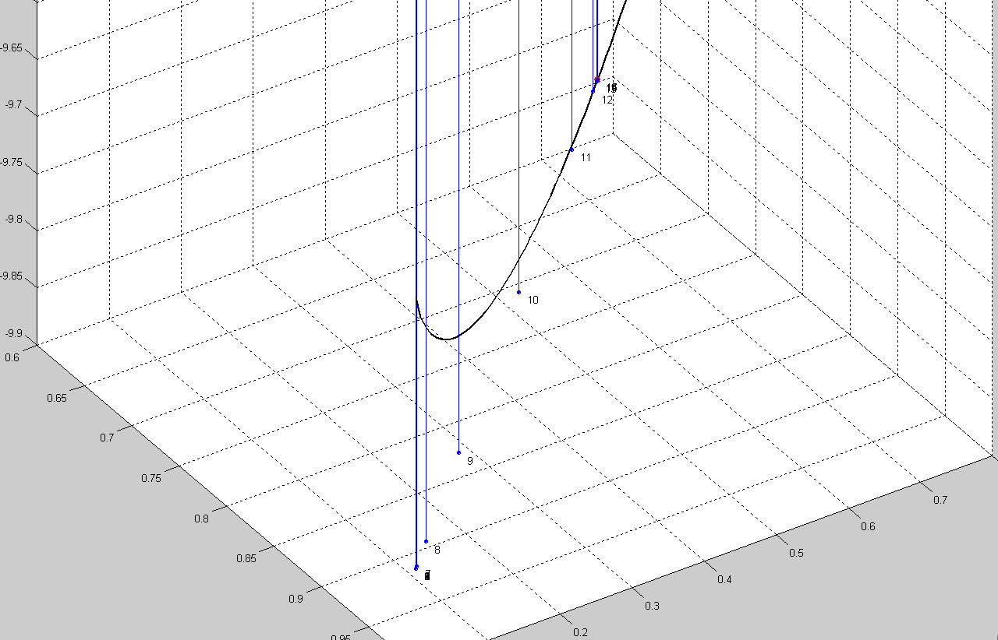
Example: Dissociation of Oxygen in the Gas Phase
T = 3700K, P = 1 atm
Equilibrium
State

Slide 7
Gibbs Free Energy of a Mixture
Sum of the number of moles of each species in the mixture each multiplied by its partial molar Gibbs function
Chemical potential of the j^{th} species
For an ideal gas mixture

Slide 8
Mixture Modeled as a Set of Ideal Gases
At high temperatures and low pressures, gaseous species can be modeled as ideal gases where
Chemical potential of the j^{th} ideal gas is given by the Gibbs free energy of gas j,
computed using Thermochemical Data Web Services*
*Paolini, C. P. and Bhattacharjee, S., A Web Service Infrastructure for Thermochemical Data, J. Chem. Inf. Model.2008; 48(7); 1511-1523.

Slide 9
dG in Terms of “Knowns” and “Unknowns”
“Knowns” calculated at runtime via Thermochemical Web Service Cyberinfrastructure:
Rewrite the transcendental term as a function of the unknown molar quantities:

Slide 10
Computing Thermodynamic Properties
NASA 7-term polynomials (B. McBride and S. Gordon, 1967)
NASA 9-term polynomials (B. McBride and S. Gordon, 1987)
Shomate polynomials (C. Howard Shomate, 1944)

Slide 11
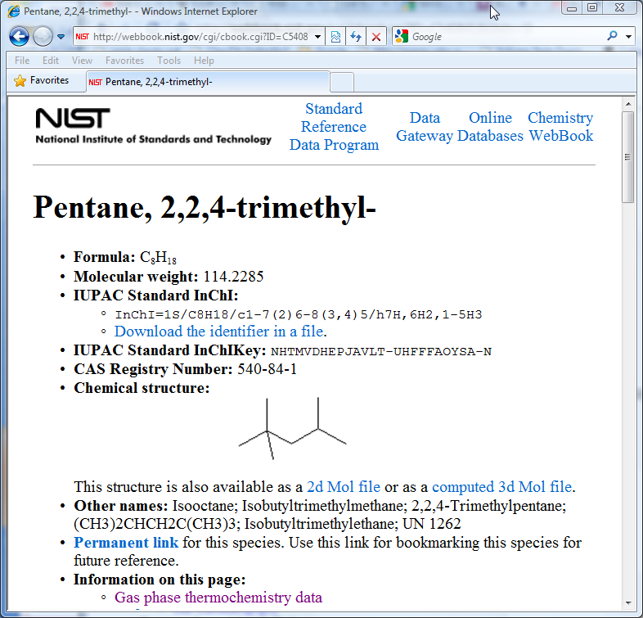
Sources of Thermodynamic Data
NASA Thermodynamic Properties of Chemical Substances to 6000 K (B. McBride and S. Gordon, 1967)
Properties given for ideal monatomic and diatomic gases, linear polyatomic molecules, and nonlinear polyatomic molecules using a Rigid Rotor Harmonic Oscillator (RRHO) model
Thermodynamic Properties of Individual Substances “TPIS” (L.V. Gurvich, 1978-1982)
Thermodynamic Database for Combustion and
Air-Pollution Use (A. Burcat and B. Ruscic, 2007)
NIST Chemistry WebBook

Slide 12
Example NASA Database Record
The coefficients a_{i} in each power series are obtained from the NASA Glenn Research Center thermodynamic databases.
Example 7- and 9-term coefficients for H₂:
H2 TPIS78H 2. 0. 0. 0.G 200.000 6000.000 2.01588 1
2.93286579E+00 8.26607967E-04-1.46402335E-07 1.54100359E-11-6.88804432E-16 2
-8.13065597E+02-1.02432887E+00 2.34433112E+00 7.98052075E-03-1.94781510E-05 3
2.01572094E-08-7.37611761E-12-9.17935173E+02 6.83010238E-01 0.00000000E+00 4
H2 Ref-Elm. Gurvich,1978 pt1 p103 pt2 p31.
3 tpis78 H 2.00 0.00 0.00 0.00 0.00 0 2.0158800 0.000
200.000 1000.0007 -2.0 -1.0 0.0 1.0 2.0 3.0 4.0 0.0 8468.102
4.078323210D+04-8.009186040D+02 8.214702010D+00-1.269714457D-02 1.753605076D-05
-1.202860270D-08 3.368093490D-12 2.682484665D+03-3.043788844D+01
1000.000 6000.0007 -2.0 -1.0 0.0 1.0 2.0 3.0 4.0 0.0 8468.102
5.608128010D+05-8.371504740D+02 2.975364532D+00 1.252249124D-03-3.740716190D-07
5.936625200D-11-3.606994100D-15 5.339824410D+03-2.202774769D+00
6000.000 20000.0007 -2.0 -1.0 0.0 1.0 2.0 3.0 4.0 0.0 8468.102
4.966884120D+08-3.147547149D+05 7.984121880D+01-8.414789210D-03 4.753248350D-07
-1.371873492D-11 1.605461756D-16 2.488433516D+06-6.695728110D+02

Slide 13
Statistical Mechanics
Standard state molar sensible enthalpy and entropy for linear molecules:
For non-linear molecules:

Slide 14
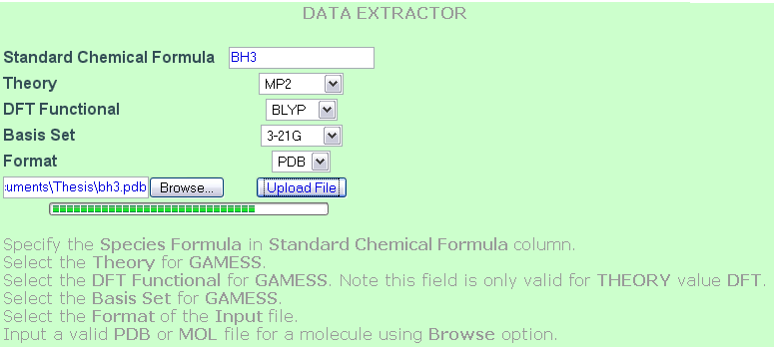
Incorporating New Thermochemical Data
GAMESS is used to incorporate new Thermochemical Data into a Web Service infrastructure
A thermochemical data extractor web application automates thermochemical property evaluation for user uploaded species
.pdb
.mol
Web Application
OpenBabel
GAMESS Input Deck configured with Restricted Hartree Fock (RHF) or Density Functional Theory (DFT) with a BLYP or B3LYP functional
GAMESS Hessian Computation
GAMESS Output Parser
Compute molecular energy, energy gradient, and energy second derivatives (Hessian) of the species, including a harmonic vibrational analysis
Extract c_{p}, s, (h-h₂₉₈) at 10 uniform discrete temperatures, vibrational frequencies, moments of inertia, symmetry, and type (linear or nonlinear)
MySQL Database

Slide 15
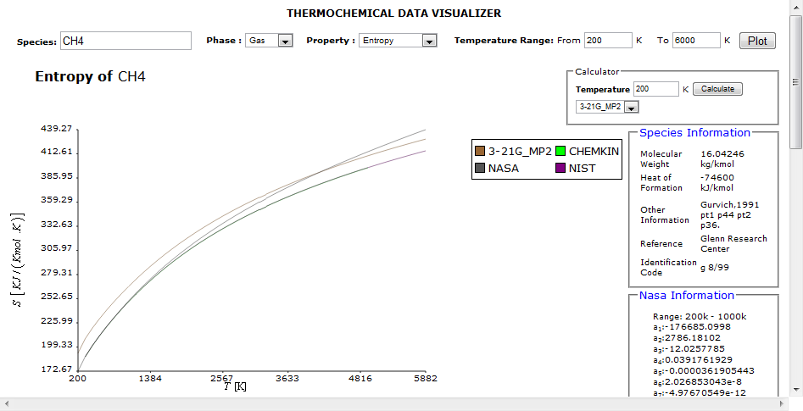
Data Visualization and Comparison
AJAX based data visualizer can immediately be invoked after thermochemistry data extraction to visually compare thermodynamic properties for a selected species among different datasets, polynomial models, and statistical mechanics models
Accessible via http://cheqs.sdsu.edu
Comparison of standard state entropy of methane gas computed using a Post-Hartree-Fock ab initio electronic structure method with entropy computed using NASA 9-term (NASA), Shomate (NIST), and NASA 7-term (CHEMKIN) polynomial data.

Slide 16
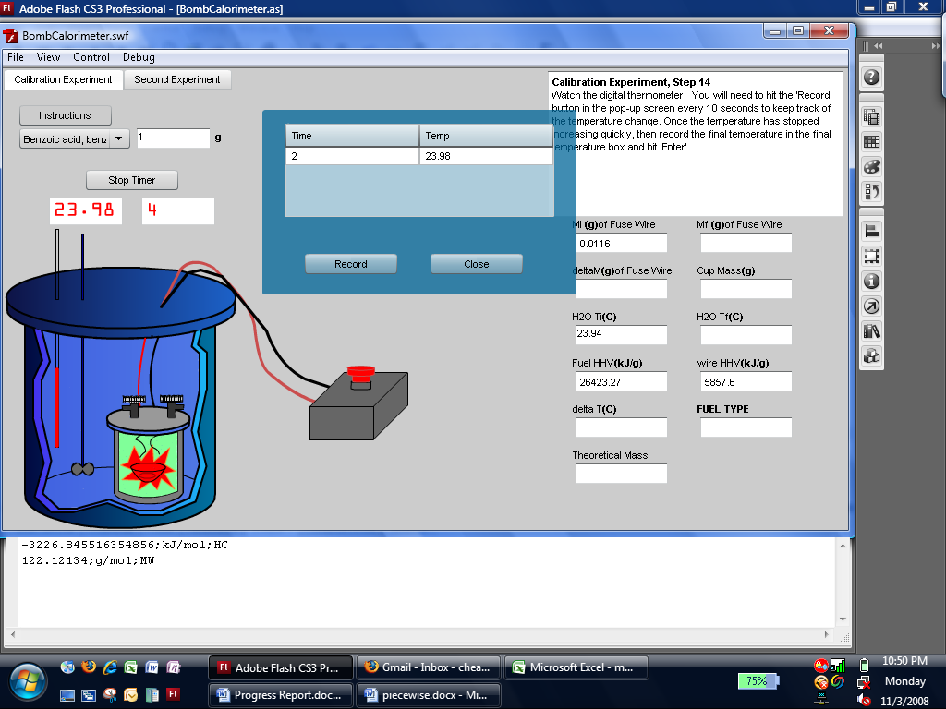
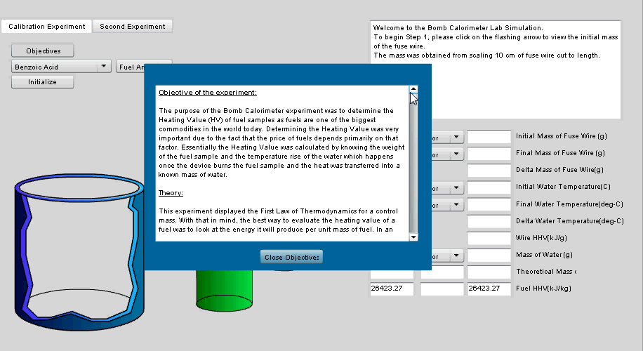
Example Application: Virtual Bomb Calorimetry
AJAX based Rich Internet Application (RIA) allows one to virtually compute the heating value of various fuels using a simulated bomb calorimeter
URL http://thermo.sdsu.edu/rias/CHEQSRias/web/BombCalorimeter.html
Benzoic Acid C₇H₆O₂ (C₆H₅COOH) in solid phase commonly used as a calorimetric standard since it has a well known enthalpy of combustion equal to -26.43 kJ/g (3227.6 kJ/mol)
Coefficients for C₇H₆O₂ not available from NIST Webbook or NASA database

Slide 17
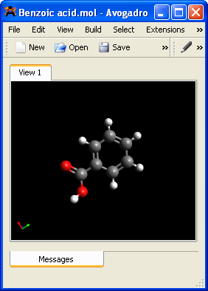
Generating Thermochemical Data for C₇H₆O₂
$CONTRL SCFTYP=RHF MAXIT=50 RUNTYP=HESSIAN COORD=CART $END
$SYSTEM TIMLIM=600000 MEMORY=25000000 $END
$STATPT NSTEP=1000 HESS=CALC $END
$DFT DFTTYP=B3LYP $END
$BASIS GBASIS=N31 NGAUSS=6 NDFUNC=1 $END
$GUESS GUESS=HUCKEL $END
$FORCE TEMP(1)=200 TEMP(2)=298.15 TEMP(3)= 317.86 TEMP(4)= 435.71
TEMP(5)= 553.57 TEMP(6)= 671.43 TEMP(7)= 789.29 TEMP(8)= 907.14
TEMP(9)= 1025 TEMP(10)= 1142.9 SCLFAC=0.96030 $END
GAMESS input file header configured for a Hessian calculation using
DFT/B3LYP/6-31G*/0.96030
$DATA
DFT/6-31G*
C1
C 6.0 -0.5045207518 -1.2025915760 -0.0555528859
C 6.0 0.1721208534 0.0232216036 0.0230566759
C 6.0 -0.5553238640 1.2201878645 0.0830072476
C 6.0 -1.9475983127 1.1919295771 0.0650679047
C 6.0 -2.6201365090 -0.0311097664 -0.0128255387
C 6.0 -1.8983667467 -1.2259176484 -0.0731906396
H 1.0 -2.4215745749 -2.1764594140 -0.1337602226
H 1.0 -3.7070097556 -0.0527168311 -0.0266302667
H 1.0 -2.5092376568 2.1210617863 0.1120129143
H 1.0 -0.0110302470 2.1572427348 0.1433955010
C 6.0 1.6562159333 0.1085280816 0.0472901580
O 8.0 2.2613197763 -1.1071376845 -0.0119042883
H 1.0 3.2186596821 -0.9228560097 0.0114714522
O 8.0 2.2945312166 1.1406493014 0.1132803247
H 1.0 0.0614199139 -2.1266157095 -0.1021896403
Avogadro molecular editor
http://avogadro.openmolecules.net/
GAMESS Cartesian input specification

Slide 18
Generating NASA Coefficients for C₇H₆O₂
NAME C6H5COOH Paolini, C.P., DFT/B3LYP/6-31G*/0.96030 July 29, 2008
C7H6O2 HF298 -385200. JOULES
DATE S07/08
REFN CHEQS THERMODYNAMIC DATA - HYDROCARBONS. San Diego State University,
REFN San Diego, CA 92182-1326. July 29, 2008.
OUTP ATM DMLESS MFIG JOULES
OUTP LSQS CTAB
METH READIN KJOULE ATM
C7H6O2T 200.000 CP 87.4910 H-H0 11.183S 313.1660
C7H6O2T 298.150 CP 126.8160 H-H0 21.691S 355.3910
C7H6O2T 317.860 CP 134.5950 H-H0 24.267S 363.7560
C7H6O2T 435.710 CP 176.4840 H-H0 42.686S 412.6960
C7H6O2T 553.570 CP 209.0530 H-H0 65.494S 458.8710
C7H6O2T 671.430 CP 233.8180 H-H0 91.657S 501.6420
C7H6O2T 789.290 CP 253.0180 H-H0 120.392S 541.0290
C7H6O2T 907.140 CP 268.2830 H-H0 151.142S 577.3160
C7H6O2T 1025.000 CP 280.6580 H-H0 183.516S 610.8530
C7H6O2T 1577.780 CP 315.8310 H-H0 349.713S 739.9920
C7H6O2T 2130.560 CP 332.1320 H-H0 529.325S 837.4660
C7H6O2T 2683.330 CP 340.6640 H-H0 715.507S 915.1230
C7H6O2T 3236.110 CP 345.5900 H-H0 905.295S 979.4200
C7H6O2T 3788.890 CP 348.6610 H-H0 1097.241S 1034.1730
C7H6O2T 4341.670 CP 350.6950 H-H0 1290.572S 1081.8000
C7H6O2T 4894.440 CP 352.1060 H-H0 1484.838S 1123.9150
C7H6O2T 5447.220 CP 353.1240 H-H0 1679.771S 1161.6490
C7H6O2T 6000.000 CP 353.8810 H-H0 1875.19S 1195.8180
FINISH
NASA PAC formatted input file for thermochemical properties of benzoic acid computed using GAMESS at the B3LYP/6-31G(d) level
GAMESS Hessian output parsed and PAC input file generated using Perl
C6H5COOH Paolini, C.P., DFT/B3LYP/6-31G*/0.96030 July 29, 2008
2 S07/08 C 7.00H 6.00O 2.00 0.00 0.00 0 122.1213400 -385200.000
200.000 1025.000 7 -2.0 -1.0 0.0 1.0 2.0 3.0 4.0 0.0 21691.000
-2.532781824D+05 5.457102530D+03-4.224389520D+01 2.050024339D-01-2.632826961D-04
1.778212852D-07-4.909939000D-11 0.000000000D+00-7.278935710D+04 2.494173460D+02
1025.000 6000.000 7 -2.0 -1.0 0.0 1.0 2.0 3.0 4.0 0.0 21691.000
4.184441950D+06-2.288193416D+04 5.530014370D+01-3.732504180D-03 6.507375260D-07
-6.070101530D-11 2.344882387D-15 0.000000000D+00 8.090522750D+04-3.267243810D+02

Slide 19
Generating Showmate Coefficients for C₇H₆O₂
NIST Chemistry WebBook uses the Shomate polynomials
Nonlinear least-squares regression performed to determine the fitted coefficients of the Shomate functions to GAMESS generated values for heat capacity, sensible enthalpy, and entropy of C₇H₆O₂
Temperature (K) | 200. - 1025. | 1025. - 6000.
A | -60.491430 | 300.761001
B | 779.476131 | 30.199412
C | -652.229469 | -5.872318
D | 210.725748 | 0.392682
E | 0.658402 | -47.669289
F | -394.243520 | -970.303432
G | 80.648508 | 552.502148
H | -385.2 | -385.2

Slide 20
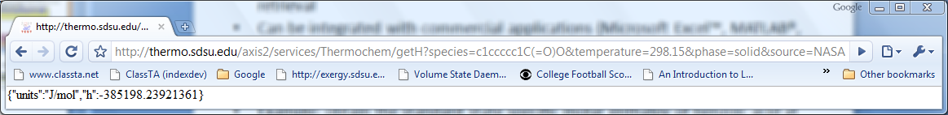
Accessing Properties through Web Services
Web Services are becoming a popular middleware technology for exchanging chemical data.
Can provide an infrastructure for thermochemical property computation and retrieval.
Can be integrated with commercial applications (Microsoft Excel™, MATLAB®, etc.) to provide support for computational thermodynamics.
Can be invoked within custom applications (Java, C, C++, FORTRAN, JavaScript, ActionScript, Adobe Air, etc.) to retrieve thermodynamic properties.
Example: obtain the standard state specific molar enthalpy of benzoic acid at 298.15 K using coefficients derived by NASA PAC:
http://thermo.sdsu.edu/axis2/services/Thermochem/getH?species=c1ccccc1C(=O)O&temperature=298.15&phase=solid&source=NASA

Slide 21
Thermochemical Web Service URL Syntax
http://thermo.sdsu.edu/axis2/services/Thermochem/getH?species=c1ccccc1C(=O)O&temperature=298.15&phase=solid&source=NASA
Scheme name: http – can pass through most company and university firewalls via the default TCP port 80
Hostname and pathname: thermo.sdsu.edu/axis2/services/Thermochem translated to Web Service endpoint reference (EPR) http://test.sdsu.edu:8080/axis2/services/Thermochem on the web server
Currently available operations:
getHC | Get enthalpy of combustion of given fuel species
getHHV | Get the higher heating value of a fuel
getH | Get enthalpy of a species in SMILES at a given temperature
getFuels | Get a list of fuel molecular formulas and SMILES specifications
getStoichiometricCoefficient | Get the stoichiometric coefficient for a given fuel
getMw | Get the molecular weight of a given species
getHByMolecularFormula | Get enthalpy of a species at a given temperature
getCp | Get specific heat of a species in SMILES at a given temperature
getCpByMolecularFormula | Get specific heat of a species at a given temperature
getSpecies | Get a JSON object of all supported species
getSByMolecularFormula | Get specific entropy of a species at a given temperature
Species identified either by molecular formula or a simplified molecular input line entry (SMILES) specification
Ex. (n-octane) CCCCCCCC or (iso-octane) CC(C)(C)CC(C)C isomer for C₈H₁₈?

Slide 22
Additional Web Service Example
Enthalpy of combustion of Acetylene (C₂H₂)
JSON sub-object from call to getFuels:
"Acetylene":{"SMILES":"C#C","molecularweight":"26.03728","phase":"gas","database":"NASA","formula":"C2H2"}
URL with ASCII value substituted for hash character (# character is reserved as a delimiter to separate a URL from a fragment identifier)
http://thermo.sdsu.edu/axis2/services/Thermochem/getHC?fuel=C%23C&phase=gas&database=NASA
JSON object returned with α=2, β=2, γ=0 and Δh_{c} = -1301 kJ/mol
{"gamma":0,"hFuel":"{\"units\":\"J/mol\",\"h\":228198.95743785193}","hCO2":"{\"units\":\"J/mol\",\"h\":-393508.2015640874}","alpha":2,"hH2O":"{\"units\":\"J/mol\",\"h\":
-285828.7815399515}","beta":2,"hc":
-1301.0441421059782,"units":"kJ/mol"}

Slide 23
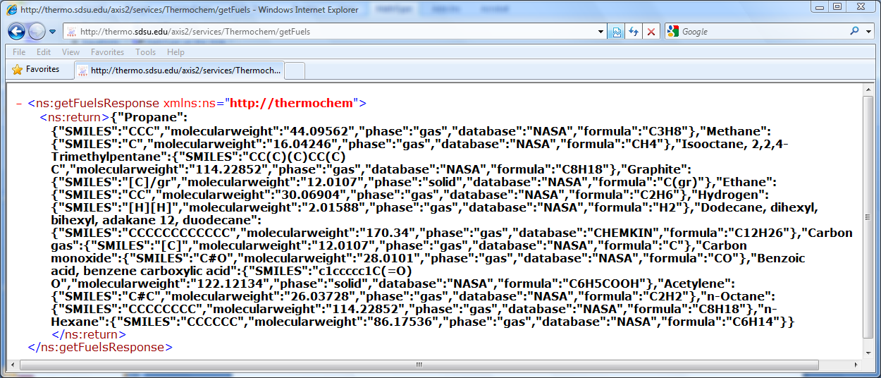
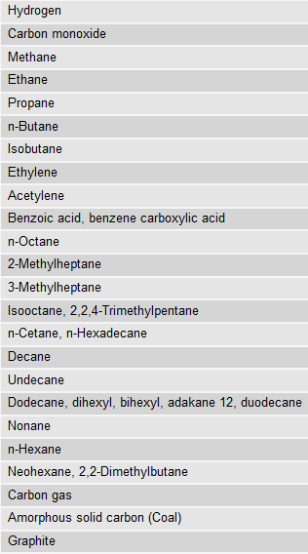
Currently Supported Fuels
http://thermo.sdsu.edu/axis2/services/Thermochem/getFuels
24 supported fuels (more being routinely added)
2,058 NASA species
112 NIST species
1,359 TDCAPU species
18 DFT or ab initio derived species

Slide 24
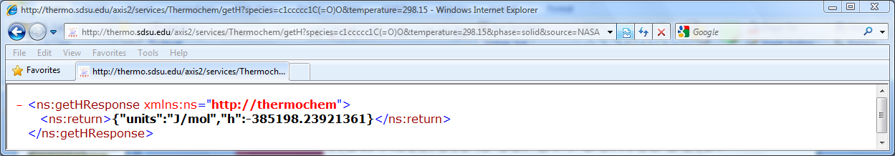
Accuracy of our DFT Derived Data for C₇H₆O₂
Standard state specific molar enthalpy of benzoic acid at 298.15 K using coefficients derived by NASA PAC:
http://thermo.sdsu.edu/axis2/services/Thermochem/getH?species=c1ccccc1C(=O)O&temperature=298.15&phase=solid&source=NASA
-386 kJ/mol: P. Landrieu, F. Baylocq, and J. Johnson, "Etude thermochimique dans la serie furanique," Bull. Soc. Chim. France, vol. 45, pp. 36-49, 1929.
-384.8 ± 0.50 kJ/mol: L. Corral, "Investigaciones termoquimicas sobre los acidos toluicos y dimetilbenzoicos," Rev. R. Acad. Cienc., vol. 54, pp. 365-403, 1960.

Slide 25
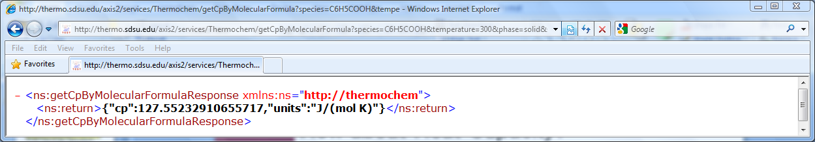
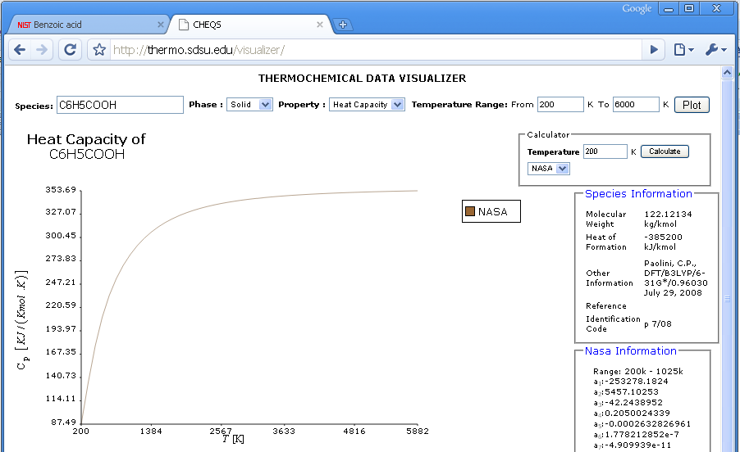
How about Heat Capacity?
http://thermo.sdsu.edu/axis2/services/Thermochem/getCpByMolecularFormula?species=C6H5COOH&temperature=300&phase=solid&source=NASA
147.78 J mol⁻¹ K⁻¹: K. Kaji, K. Tochigi, Y. Misawa, and T. Suzuki, "An adiabatic calorimeter for samples of mass less than 0.1 g and heat capacity measurements on benzoic acid at temperatures from 19 K to 312 K," J. Chem. Thermodynam., vol. 25, no. 6, pp. 699-709, 1993.
Thermochemical Data Visualizer plot of the
standard state molar heat capacity of benzoic
acid

Slide 26
Nonlinear Constrained Minimization
Bound by the mass balance constraints
Expressed as a set of equality constraints

Slide 27
The “Method of
Element Potentials”
To satisfy
the terms in the square brackets must vanish to 0.
since

Slide 28
m Equations in a Multipliers and m N_{j}s
Determining an equilibrium composition reduces to solving m non-linear equations for the unknown
e.g.

Slide 29
Interpretation of the Lagrange Multiplier λ_{i}
The i^{th} Lagrangian multiplier is the element potential for the i^{th} atom. Each atom in the product mixture contributes the same amount to the partial molar Gibbs function of any species to which it belongs. Consequently, this numerical approach is called the element potential method.
Notes:
29

Slide 30
Newton-Raphson Iterative Descent Method
Express each function as
First order Taylor approximation:
Iteratively solve for corrections and generate new estimates until a convergence criterion is satisfied.

Slide 31
Resulting Rank “Block” System

Slide 32
Reduction to a Rank “Dense” System
Solve for :
Substitute into the atomic population constraint equations and the total system moles constraint equation to form a dense system bounded by the number of unique atoms (few: ~5=C,O,H,N,S)

Slide 33
The Method of Element Potentials:
Existence and Uniqueness
Single phase systems consisting of species modeled as ideal gases will have a unique solution that minimizes for a particular temperature and pressure.
Gibbs function of a single phase system of ideal gases is convex (proof: W.R. Smith and R.W. Missen, 1991).
For multiphase systems of ideal gases it can be shown that two or more different distributions, say and, , could exist and yield the same minimum Gibbs value.

Slide 34
The Method of Element Potentials: Condensates
Gibbs function (i.e. chemical potential) of a condensed species j does not depend on pressure (i.e. ).
Solution without considering condensates is first obtained.
After solution converges containing only gaseous species, introduce one condensate that satisfies the Zeleznik and Gordon Vapor Pressure Test and then restart the problem. Repeat until all condensates have been considered.
The Vapor Pressure Test determines which phase lowers the overall Gibbs value more.

Slide 35
The Method of Element Potentials:
Augmented Matrix with Condensed Species

Slide 36
The Method of Element Potentials:
Species Updates
Solution vector after each iteration:
Correction equation for each
gaseous species:
For each condensate:
And the total number of
moles in the system:
and

Slide 37
The Method of Element Potentials:
Under-relaxation
Without under-relaxation, large adjustments in the number of moles of gaseous species having trace amounts may be taken which could lead to divergence
Two candidate sub-parameters
Restricts the change in the number of moles in the system of any gaseous species to e².
Limits the increase of the j^{th} gaseous species’ mole fraction from exceeding 10⁻⁴.

Slide 38
The Method of Element Potentials: Convergence Criteria
We employ the NASA CEA convergence criteria as follows:
For all gaseous species:
For all condensed species:
For the total number of moles in the system:

Slide 39
The Method of Element Potentials: Initialization Strategy
The Newton-Raphson method requires an initial guessed solution that is reasonably close to the true root or solution of system.
Express as a linear equation by discarding the transcendental term:
Standard linear programming (LP) problem
solved using the SIMPLEX algorithm.

Slide 40
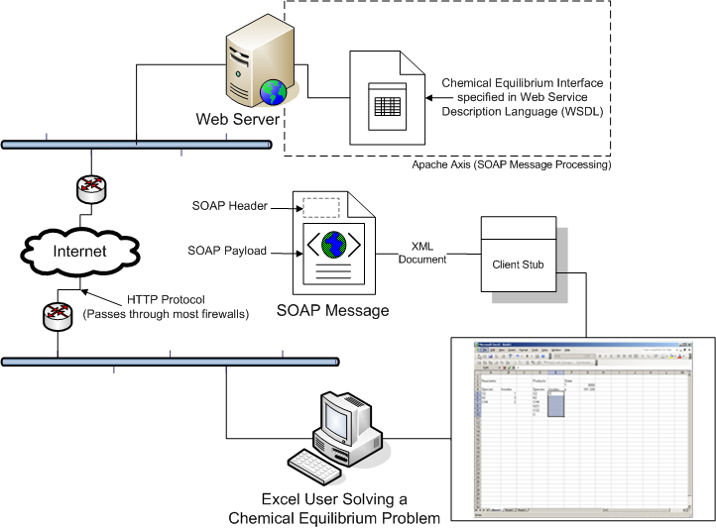
Service Oriented Architectural Model
Notes:
40

Slide 41

Benefits of Web Services
Platform and architecture neutrality
W3C standards for accessibility (WSDL)
W3C standards for discovery (UDDI, ebXML)
Can use HTTP for transport – usually passes through firewalls
Easy to call in all modern programming languages
Easy to develop and deploy
Supported by grid technologies (Condor, Globus)
Can be invoked from within many commercial applications (Excel, MATLAB)
Ref: Sun Microsystems

Slide 42
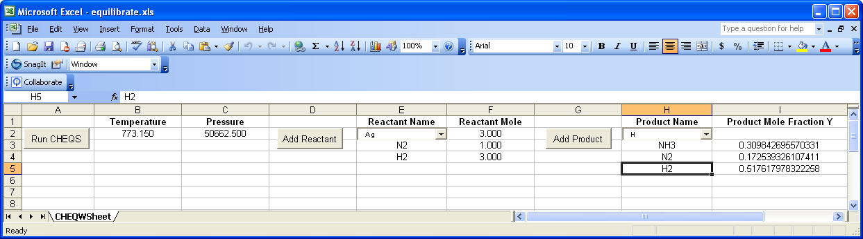
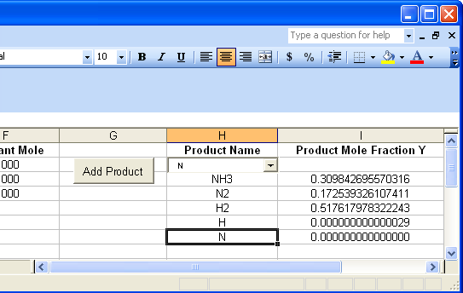
Equilibrium Web Service Example:
Using Microsoft Excel
Excel interface to our chemical equilibrium Web Service
Microsoft Excel Chemical Equilibrium Spreadsheet downloadable via http://cheqs.sdsu.edu/
Using the Excel interface to solve a what-if question: is monatomic hydrogen and nitrogen present in the product mixture?

Slide 43
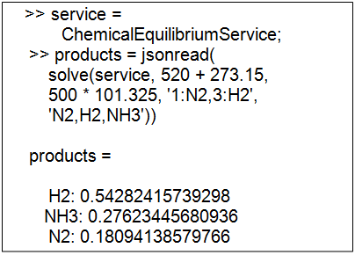
Equilibrium Web Service Example:
Using MATLAB
MATLAB interface to our chemical equilibrium Web Service
Toolbox of M-Files is currently under development and will be available for downloading from http://cheqs.sdsu.edu/
Equilibrium mole fractions of hydrogen, ammonia, and nitrogen.

Slide 44
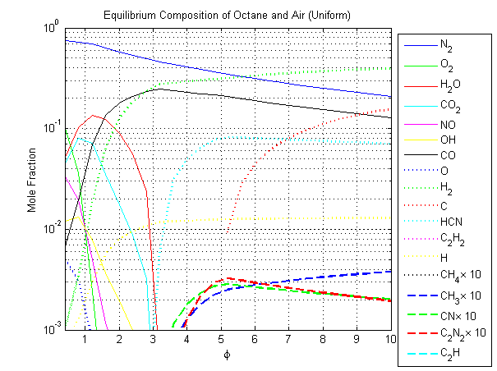
Emissions Analysis Plot Generated Via The Equilibrium and thermochemical Data CI

Slide 45
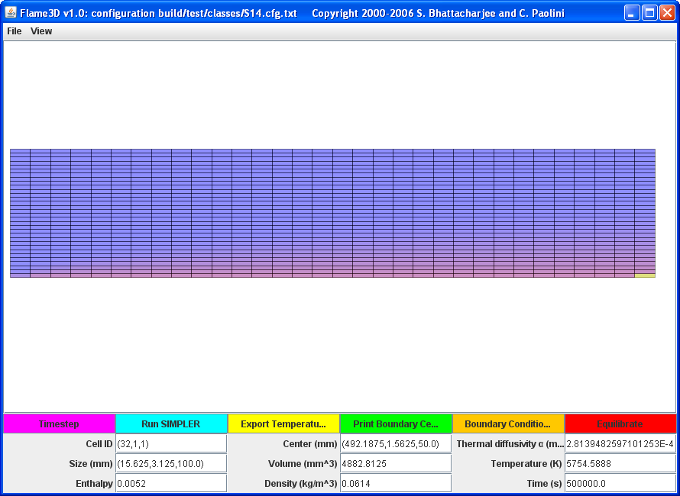
Coupling Equilibrium and Thermochemical Data Web Services with CFD
To demonstrate how existing tools can be coupled with our thermochemical data and equilibrium Web Services, we extended the capabilities of Flame3D, an object-oriented implementation of the Semi-Implicit Method for Pressure-Linked Equations (“SIMPLE”) algorithm of Patankar and Spalding, to be able to compute the equilibrium distribution of every control volume after a steady-state temperature field has been computed.
Temperature profile of a steady-state (“slug”) flow of carbon dioxide over a semi-infinite flat plate at 6000K. Ambient temperature is configured at 300K. Computational domain consists of 1024 control volumes.

Slide 46
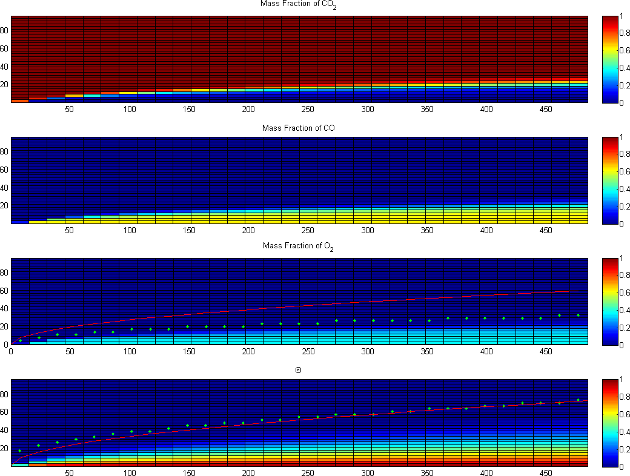
Coupling Equilibrium and Thermochemical Data Web Services with CFD
Concentration and thermal boundary layers of a steady-state (“slug”) flow. Theta is dimensionless temperature and the yellow line is the thermal boundary layer with distance at the right wall. Units on the x- and y-axis are in mm.
Theta is dimensionless temperature given by
where and

Slide 47
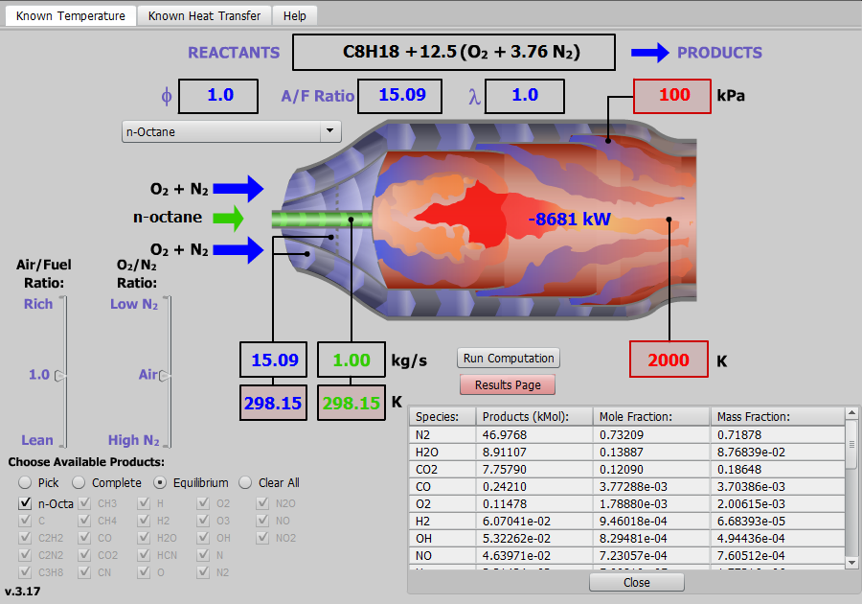
Integration with Thermodynamic RIAs
http://thermo.sdsu.edu/rias/CHEQSRias/web/CombustionChamber.html
Example combustion chamber RIA developed by research our group
Integrates thermochemical property Web Services and chemical equilibrium Web Services with an Adobe Flash GUI

Slide 48
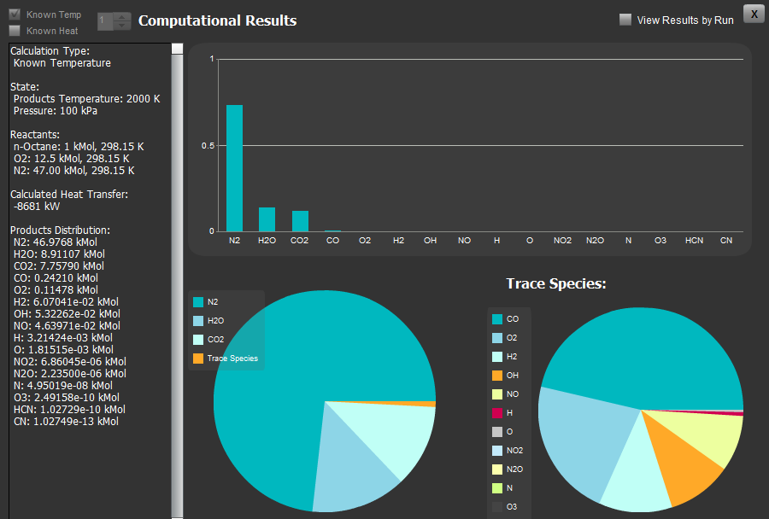
Integration with Thermodynamic RIAs cont.
Equilibrium distribution and computed heat transfer shown in a separate window.
Results are presented numerically and graphically.

Slide 49

Simulating H₂ and O₂ Combustion
Mechanism consists of 23 reactions
Set of reactions and Arrhenius equation parameters obtained from the UC Berkeley GRI-Mech kinetics database
http://www.me.berkeley.edu/gri_mech/
Notes:
49

Slide 50
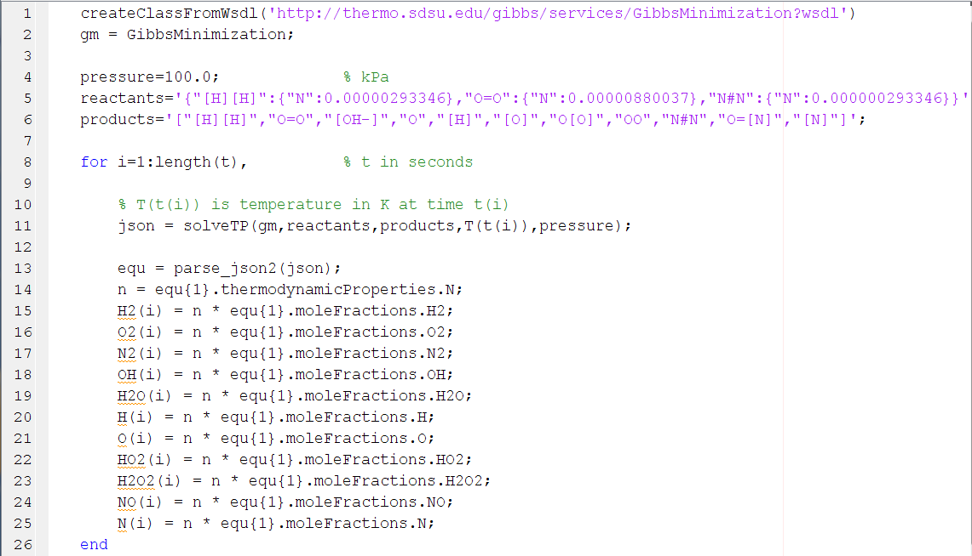
MATLAB Example

Slide 51
Kinetic v. Equilibrium Comparison
Concentrations derived from numerical integration of rate equations.
Concentrations derived from Gibbs function minimization at each temperature T_{t} at time t.

Slide 52
“Equilibrium Time” of a Reaction
We can define the equilibrium time or p-time of the reaction,
where NG is the number of gaseous species in the system.
The p-time gives the time for a reaction to approximately reach an equilibrium state.

Slide 53
Some Concluding Remarks
Current trend in software development is to make use of distributed software components hosted on remote systems accessible through the Internet.
Thermophysical software applications can make use of these distributed components by calling Web Services in client code.
Web Services provides the developer a modern alternative to storing, in software, coefficients of polynomials that represent thermodynamic functions.
We developed an infrastructure of Web Services that allows a user to upload a manually constructed and geometrically optimized molecule which is then submitted to our publically accessible GAMESS cluster to compute the energy Hessian and vibrational frequencies.
Thermochemical data produced by GAMESS is automatically extracted, fit using a nonlinear least-squares regression, and the coefficients of the fit NASA 9-term polynomial are stored in a relational database.
Users can then retrieve thermodynamic properties of their uploaded species though our publically accessible Web Service infrastructure.
Data retrieved using this Web Service infrastructure can be used to compare ab initio and semi empirical derived properties against existing thermochemical databases.

Slide 54
Recent Publications
Paolini, C. P., Jain, H. B., and Bhattacharjee, S., Integration of Thermodynamic Properties from Different Databases with Data Derived from DFT and Ab-Initio Methods, and their Delivery through Web Services, Seventeenth Symposium on Thermophysical Properties, June 21–26, 2009, Boulder, CO, paper #513.
Bhattacharjee, S. and Paolini, C. P., The Chemical Thermodynamic Module of The Expert System for Thermodynamics (“TEST”) Web Application, 2009 ASEE Annual Conference & Exposition, June 14–17, 2009, Austin, TX.
Paolini, C. P. and Bhattacharjee, S., A Web Service Infrastructure for Distributed Chemical Equilibrium Computation, Proceedings of the 6th International Conference on Computational Heat and Mass Transfer (ICCHMT), May 18–21, 2009, Guangzhou, China, p. 413-418.
Bhattacharjee, S. and Paolini, C. P., Property Evaluation in The Expert System for Thermodynamics ("TEST") Web Application, Journal of Computer Coupling of Phase Diagrams and Thermochemistry - CALPHAD (2008), doi:10.1016/j.calphad.2008.10.008.
Paolini, C. P. and Bhattacharjee, S., An Object-Oriented Online Tool for Solving Generalized Chemical Equilibrium Problems, Proceedings of the 2008 ASME International Mechanical Engineering Congress and Exposition IMECE08, October 31 – November 6, 2008, Boston, Massachusetts, USA.
Paolini, C. P. and Bhattacharjee, S., A Web Service Infrastructure for Thermochemical Data, J. Chem. Inf. Model. 2008; 48(7); 1511-1523.
Notes:
54

Slide 55
END
SLIDE

